Slide 1
Personal Portfolio – Web Development project
Personal Portfolio
Presented By Bismit Bhawal
Course - WEB DEVELOPMENT

Slide 2
Introduction
Purpose of the Project:
To build a personal portfolio to showcase
my skills, projects, and achievements.
Why this project?
Essential for professional branding
Demonstrates frontend development skill
Helps during internships and placements

Slide 3

Technologies Used
Frontend:
HTML
CSS3
JavaScript
Tools/Frameworks (if used):
Bootstrap / Tailwind CSS
VS Code
Git & GitHub for version control
Hosting Platform:
GitHub Pages / Netlify / Vercel

Slide 4
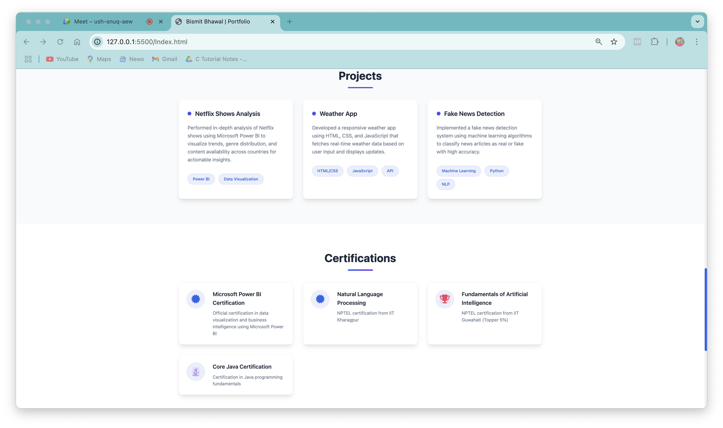
Project Features
Navigation Sections:
Home, About, Skills, Projects,
Contact
Responsive Design:
Works on mobile, tablet, and
desktop
Interactive Elements:
Scroll animations, hover effects,
form submission
Contact Form:
Integrated with EmailJS / Google
Form / Backend script

Slide 5
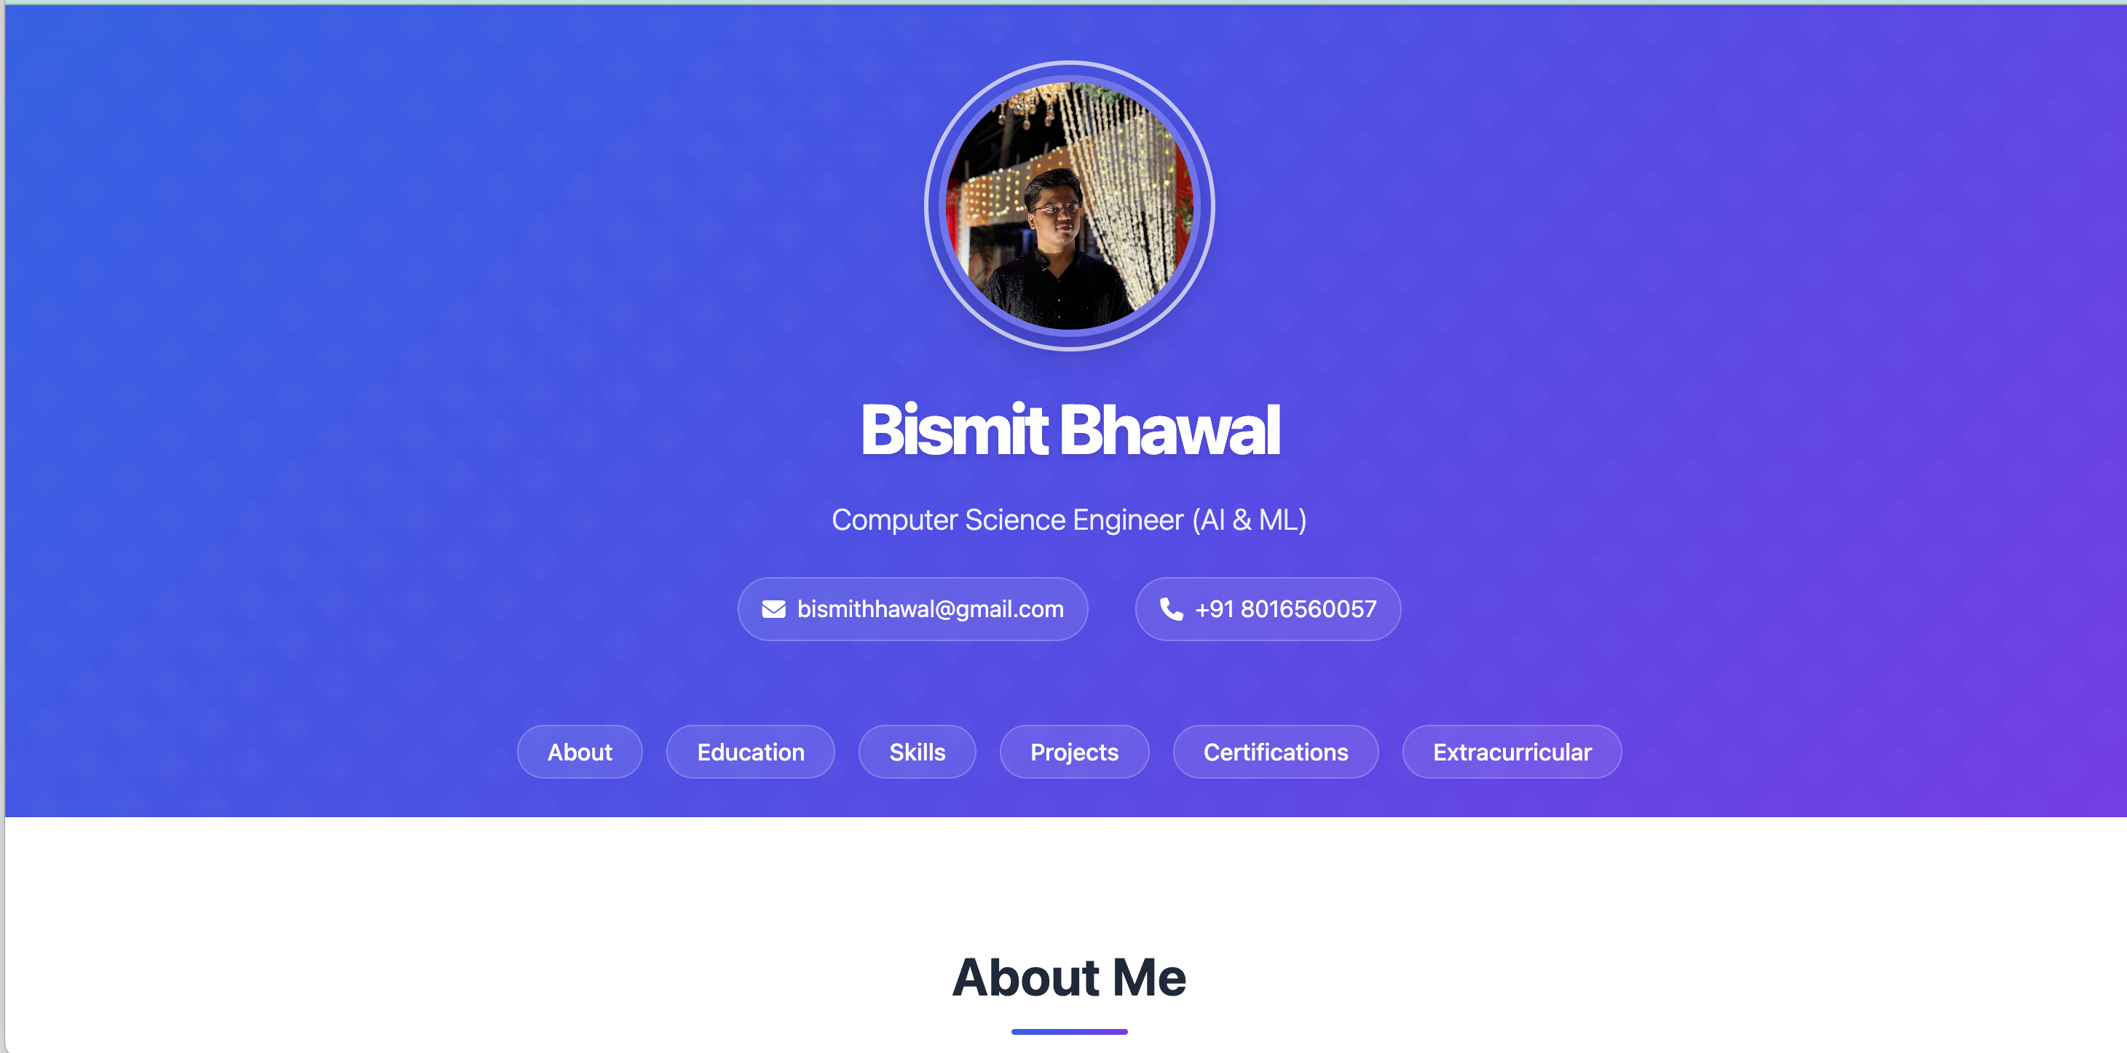
Working

Slide 6
Challenges & Solutions
Responsive Layout: Used media queries and flexbox/grid
Form Handling: Used client-side validation or EmailJS
Design: Ensured UI/UX consistency with color palette & fonts
Version Control: Regular commits and issue tracking on GitHub

Slide 7
Conclusion & Future Scope
Conclusion:
Successfully built a professional online
presence
Gained experience in frontend and web
hosting
Future Enhancements:
Add a blog section
Integrate backend with Node.js / Firebase
Include testimonials and resume download
feature

